Slide 1


Slide 2

History
Originally established in 1994 as VoiceStream Wireless PCS
Purchased by Deutsche Telekom in 2001 and renamed
Western United States based company
Headquarters in Bellevue Washington
3rd largest wireless carrier in the US with 72.6 million customers
In 2013 they become known as the “Un-carrier”
T-voice in 2015 illegal company union
Today Sprint and T-mobile are seeking to merge companies
Notes:
https://en.wikipedia.org/wiki/T-Mobile_US#History
Add T-voice
http://fortune.com/2017/04/04/labor-judge-says-t-mobile-must-disband-illegal-union/

Slide 3
SWOT Analysis
Strengths
Largest global data coverage w/ no charge
Companies switching incentives
Discount carrier option (metro pcs)
Customer Service
Family plans
Weakness
Poor financial planning
3rd fastest network
High attrition rate
Mixing of company culture
Notes:
http://fernfortuniversity.com/term-papers/swot/nyse/3976-t-mobile-us--inc-.php

Slide 4
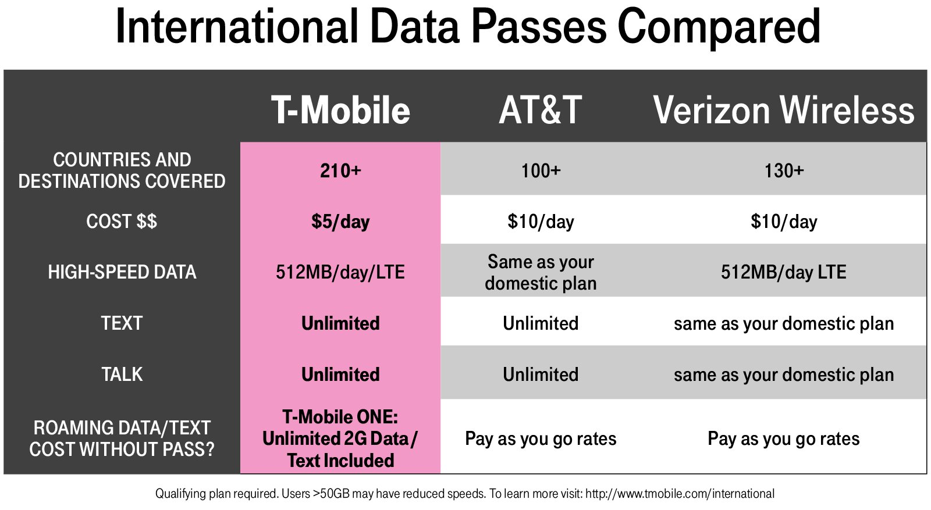

Slide 5
SWOT Analysis
Opportunities
Company merging
Increase wireless coverage
Increase variety of plans
Improve company image and culture
Threats
Speed comparisons with AT&T & Verizon
Competitors lowering prices
Product selection
No regular innovative product / ideas
Notes:
http://fernfortuniversity.com/term-papers/swot/nyse/3976-t-mobile-us--inc-.php

Slide 6
PESTEL
Political
Economic
Socio-Cultural
Cost of Building new infrastructure
Inflation Rates
Interest Rates
Exchange Rates
Demographics
International and Local Culture
Supported Trump Administration’s attack on Net Neutrality
T-Voice
Political Stability - Importance of telecommunication in the economy
Notes:
Political:
Antitrust Laws - While attempting to create fair competition in the industry, these government regulations can also prevent positive growth
Wage Legislation - The Increase in minimum wage puts strain on companies with lots of part time employees
Political Stability - Investors have started to look at mobile penetration as a predictor of political stability. Communication through mobile devices can make the transfer of knowledge easier. In 2009 a UN white paper on telecommunications and Industrial development came to the conclusion that infrastructure for telecommunications causes manufacturing growth.
Economic:
Cost of Building New Infrastructure
Inflation rates - telecommunication companies are almost immediately negatively impacted by inflation rates
Interest Rates - similarly telecommunications companies stock prices are very sensitive to fluctuation in interest rates
Exchange Rates -
Socio-Cultural:
Demographics - about 20% of people in America do not utilize mobile devices. Changes in demographics affect sales and contract rates
International and Local Culture - while T-mobile doesn’t have as high of a presence in countries other than America, they do offer an International mobile and landline calling for free to Canada and Mexico. They offer the same plan in 33 other countries.

Slide 7

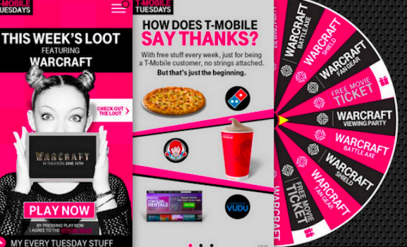
PESTEL
Notes:
Political:
Antitrust Laws - While attempting to create fair competition in the industry, these government regulations can also prevent positive growth
Wage Legislation - The Increase in minimum wage puts strain on companies with lots of part time employees
Political Stability - Investors have started to look at mobile penetration as a predictor of political stability. Communication through mobile devices can make the transfer of knowledge easier. In 2009 a UN white paper on telecommunications and Industrial development came to the conclusion that infrastructure for telecommunications causes manufacturing growth.
Economic:
Cost of Building New Infrastructure
Inflation rates - telecommunication companies are almost immediately negatively impacted by inflation rates
Interest Rates - similarly telecommunications companies stock prices are very sensitive to fluctuation in interest rates
Exchange Rates -
Socio-Cultural:
Demographics - about 20% of people in America do not utilize mobile devices. Changes in demographics affect sales and contract rates
International and Local Culture - while T-mobile doesn’t have as high of a presence in countries other than America, they do offer an International mobile and landline calling for free to Canada and Mexico. They offer the same plan in 33 other countries.

Slide 8
PESTEL
Technological
Environmental
Legal
Competitor’s Technology
Rate of diffusion for technology
Weather
Laws regarding Environmental Pollution
Public’s attitude towards renewable energy
Copyrights/Patents
Consumer protections and ecommerce

Slide 9


VRIO
 | Valuable | Rare | Costly to Imitate | Capturing Value | Sustainable Advantage?
“Un-Carrier” |  |  |  |  | Sustainable
Brand Awareness |  |  |  |  | Competitive Parity
International Phone Plan |  |  |  |  | Competitive Parity
Customer Loyalty |  |  |  |  | Sustainable
Pricing Strategy |  |  |  |  | Competitive Parity
Notes:
Un-carrier: t-mobile doesn't offer two year contracts and offers subsidized phones, etc.
Rare and Costly b/c they’re the only ones who are doing it. If other companies were to give up those contracts they could potentially lose customers
Brand: Not Rare or Costly b/c all four of the major carriers in the U.S. have strong brand awareness, especially through social media
International Phone Plan: Not Rare b/c while T-mobile is currently offering the most affordable international data plans to customers, Verizon, AT&T and Sprint are all offering similar plans
Customer Loyalty: Yes Rare and Valuable. An article from Business Insiders states that T-Mobile had the best customer loyalty out of all of the US carriers
Pricing Strategy: Not Rare or costly because it is such a competitive industry so the prices are roughly the same.

Slide 10
Porter’s 5 Forces
 | Impact | Factor
Competition | High | AT&T, Verizon
Suppliers | Low | Multi year agreement with Ericsson
Customers | High | Cost and Service Sensitive
Substitution | Medium | Skype, Discord, Whatsapp
New Entrants | High | Infrastructure

Slide 11
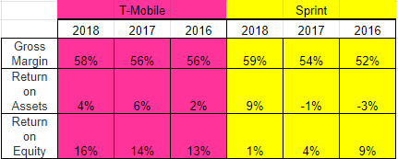
Financial Ratios: T-Mobile vs Sprint
Notes:
https://s22.q4cdn.com/194431217/files/doc_financials/2017/annual/1500109984.pdf

Slide 12
T-Mobile and Sustained Competitive Advantage
Does T-Mobile have a sustained competitive advantage?
 | T-Mobile | Sprint | AT&T | Verizon
Net Income 2018 | $2,888,000 | $7,389,000 | $19,370,000 | $15,528,000

Slide 13
Discussion Questions
T-Mobile claims that a successful merge with Sprint will create greater competition and therefore better prices for customers. Do you agree with this statement?
How can T-Mobile continue to differentiate themselves to obtain competitive advantage?

